Slide 1
Industry Partners for Green Academy Programs
Porterville High School
Alternative Energy Resource Occupations
CPA Green Academy

Slide 2
About the Porterville High School AERO Academy
AERO – CA Partnership “Green” Academy
Alternative Energy Resource Occupations
To prepare students for College and Career opportunities
Main Focus- Renewable or Alternative Energy Technology:
Solar, Wind, Biomass, Geothermal, Hydroelectricity,
Building Trades-Green Construction and Building Performance
Transportation-Alternative Energy Drivetrain & Fuels
Porterville High School-located in the Central Valley against the Sierra Nevada Mountains between Fresno and Bakersfield

Slide 3
AERO Academy Mission Statement
The mission of AERO is to provide students a dynamic, engaging and effective educational experience that prepares students with the skills to be productive citizens in a global society. AERO emphasizes academic preparation for “college and career”, with skills for success in the real world. Students work as a team with teachers, businesses, technical experts and mentors. Students focus on Energy and Green Technology as a career field of study, engaged in rigorous core curriculum, blended with demanding technical skills, and real world experience.

Slide 4
Porterville High School AERO Academy-Industry Partners
Sunpower Corporation
City of Porterville
Wells Fargo Bank
Emerald Energy
Southern CA Edison
GRID Alternatives
Porterville Historical Museum
Circle J Norris Ranch

Slide 5
Benefits of Industry Partners
Availability to new and emerging technologies
Training and Internship opportunities
Real-World applications of curriculum to AERO Academy students
Exposure of AERO students, Porterville High School, and PUSD to industry
Students build personal and professional relationships, add to 21st Century skillset

Slide 6
Sunpower Corporation
PUSD partnered with Sunpower and installed a 7.3 MW Solar system in 2012 at our high school/adult school campuses, 693 KW on the PHS Campus
AERO had partnered and developed with Sunpower a Summer Solar Camp for internship opportunities for AERO students
Sunpower has made information and technology available to our students in the classroom.

Slide 7
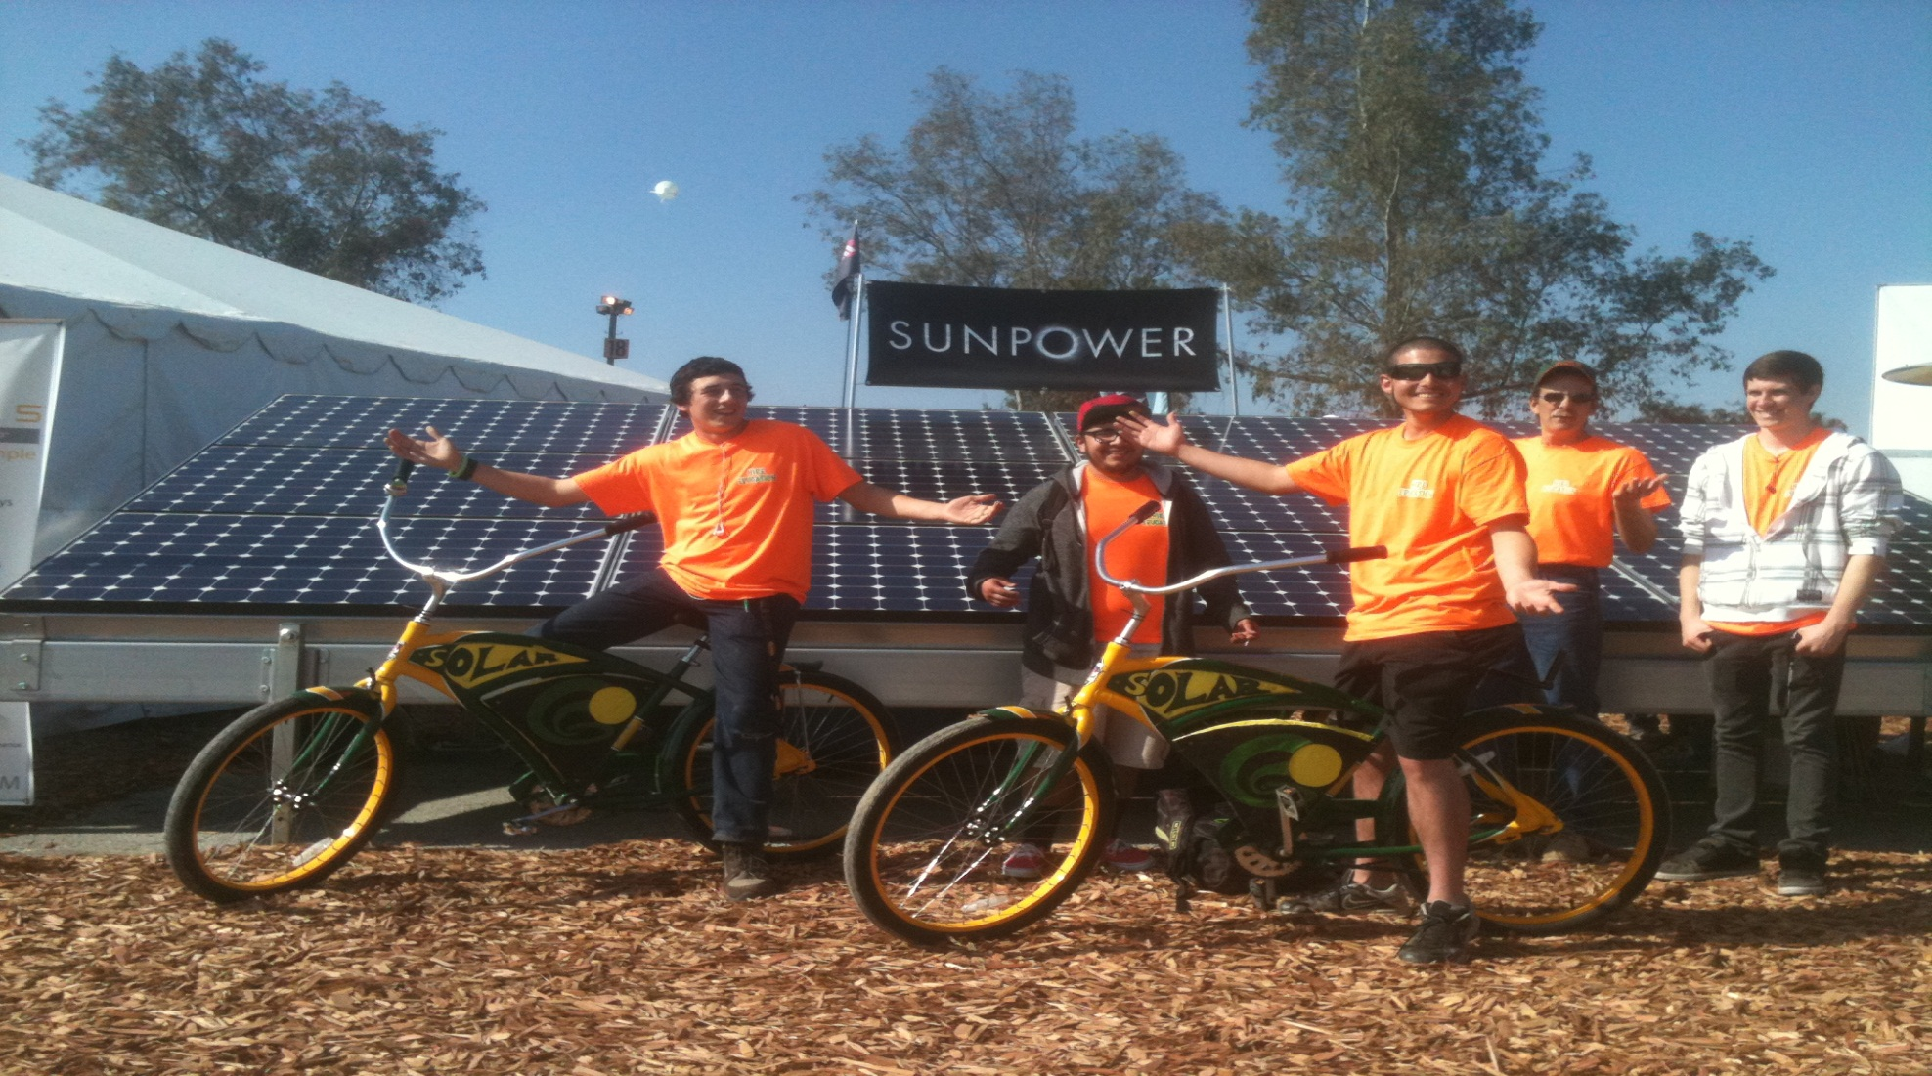
We LOVE Sunpower!

Slide 8
PUSD Summer Solar Summer Camp Installation tour at Harmony Magnet Academy Campus

Slide 9
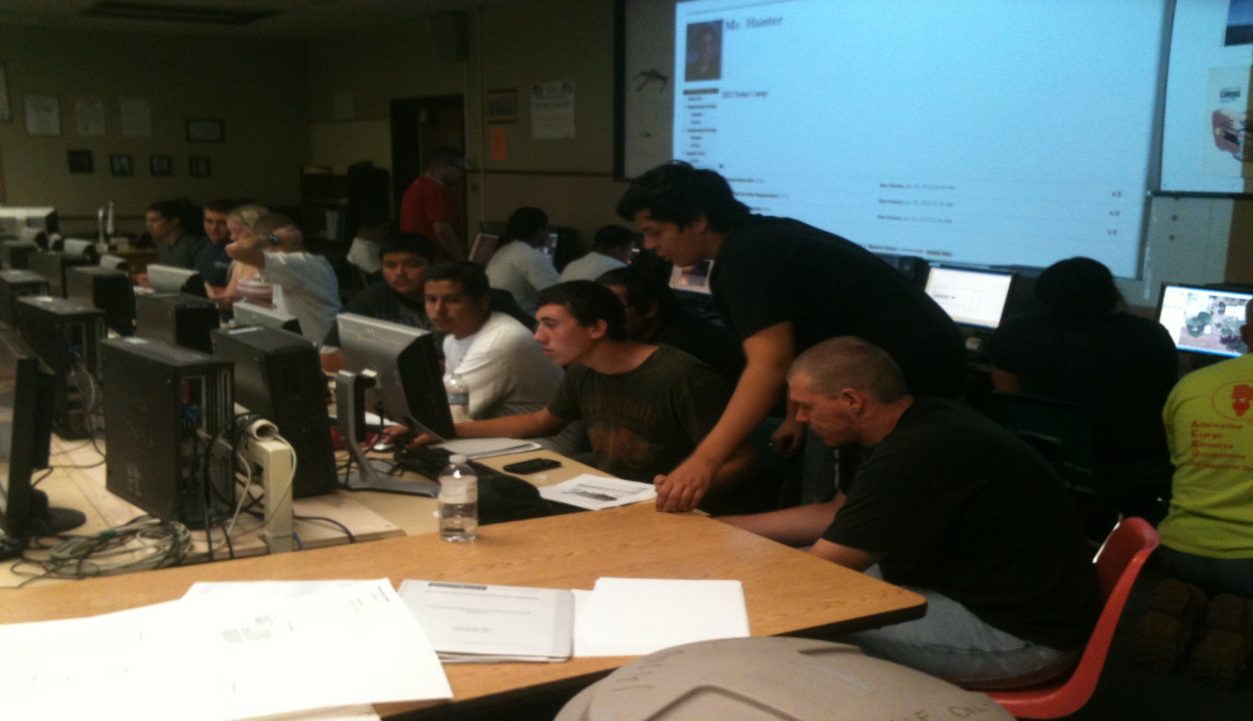
Student Team Presentations

Slide 10
Student Team Presentations

Slide 11
City of Porterville
Helped provide assistance with acquiring home donation from Wells Fargo Bank.
Working as a partner during the remodeling of the new Porterville Police Dept. Training Center
Students work at new PPD Training Facility as Interns for Contractors

Slide 12
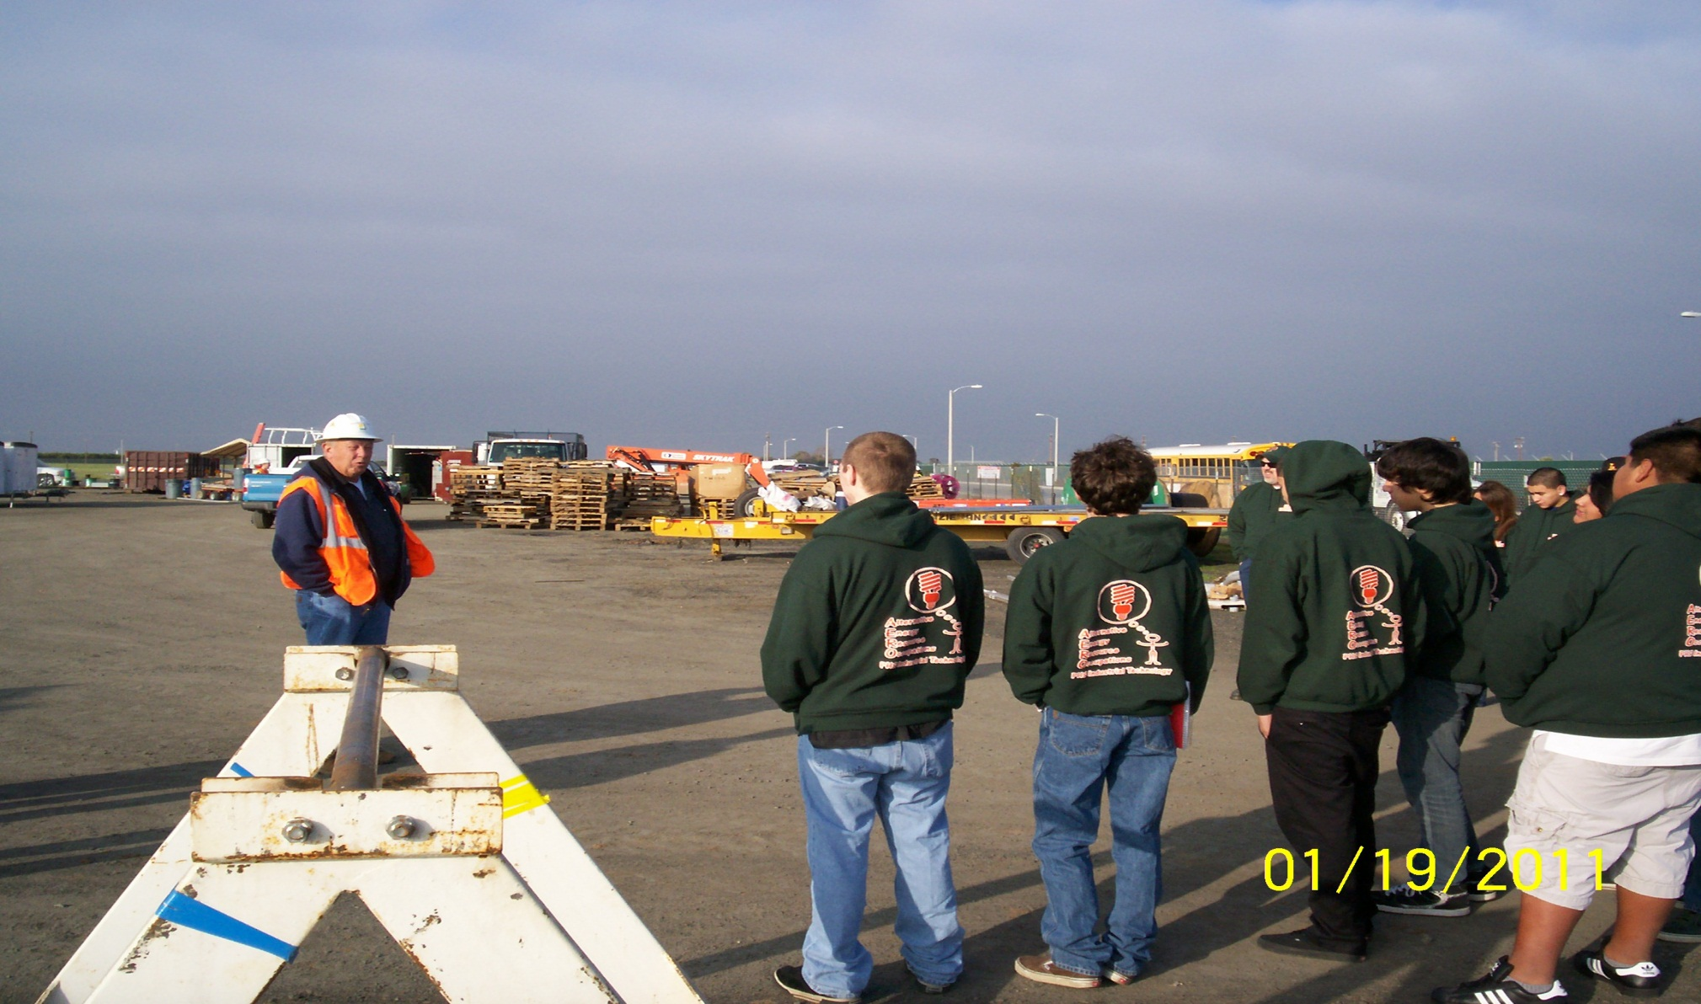
COP/SCE Solar Farm

Slide 13
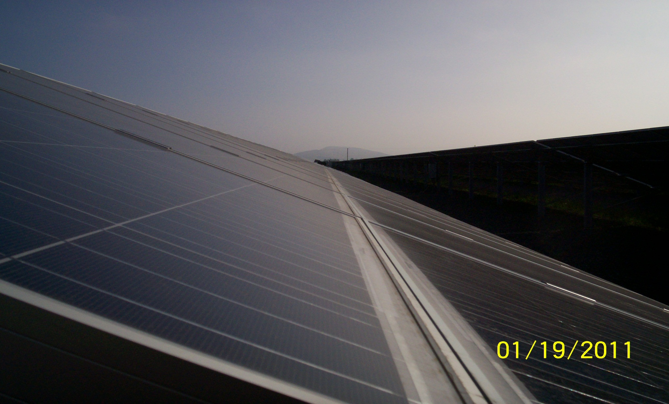
COP/SCE Solar Farm

Slide 14
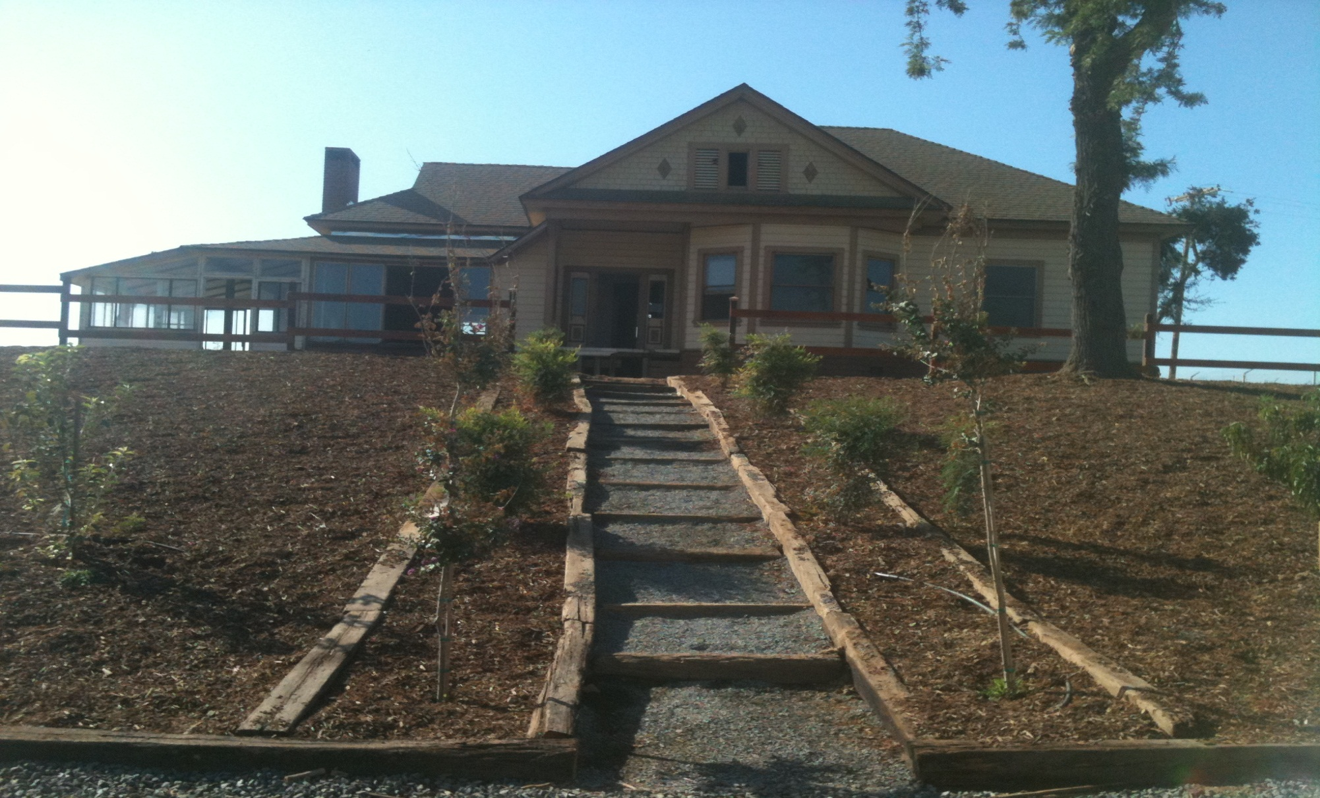
City of Porterville-Police Training Facility

Slide 15
Wells Fargo
Donated a foreclosure home to the AERO Academy for student curriculum
This home will repaired, remodeled, and sold to the public. Profits from this home will be used for future home projects like this.
Students will perform all work related to home improvement, Renewable Energy, and Building Performance to improve value to this house

Slide 16
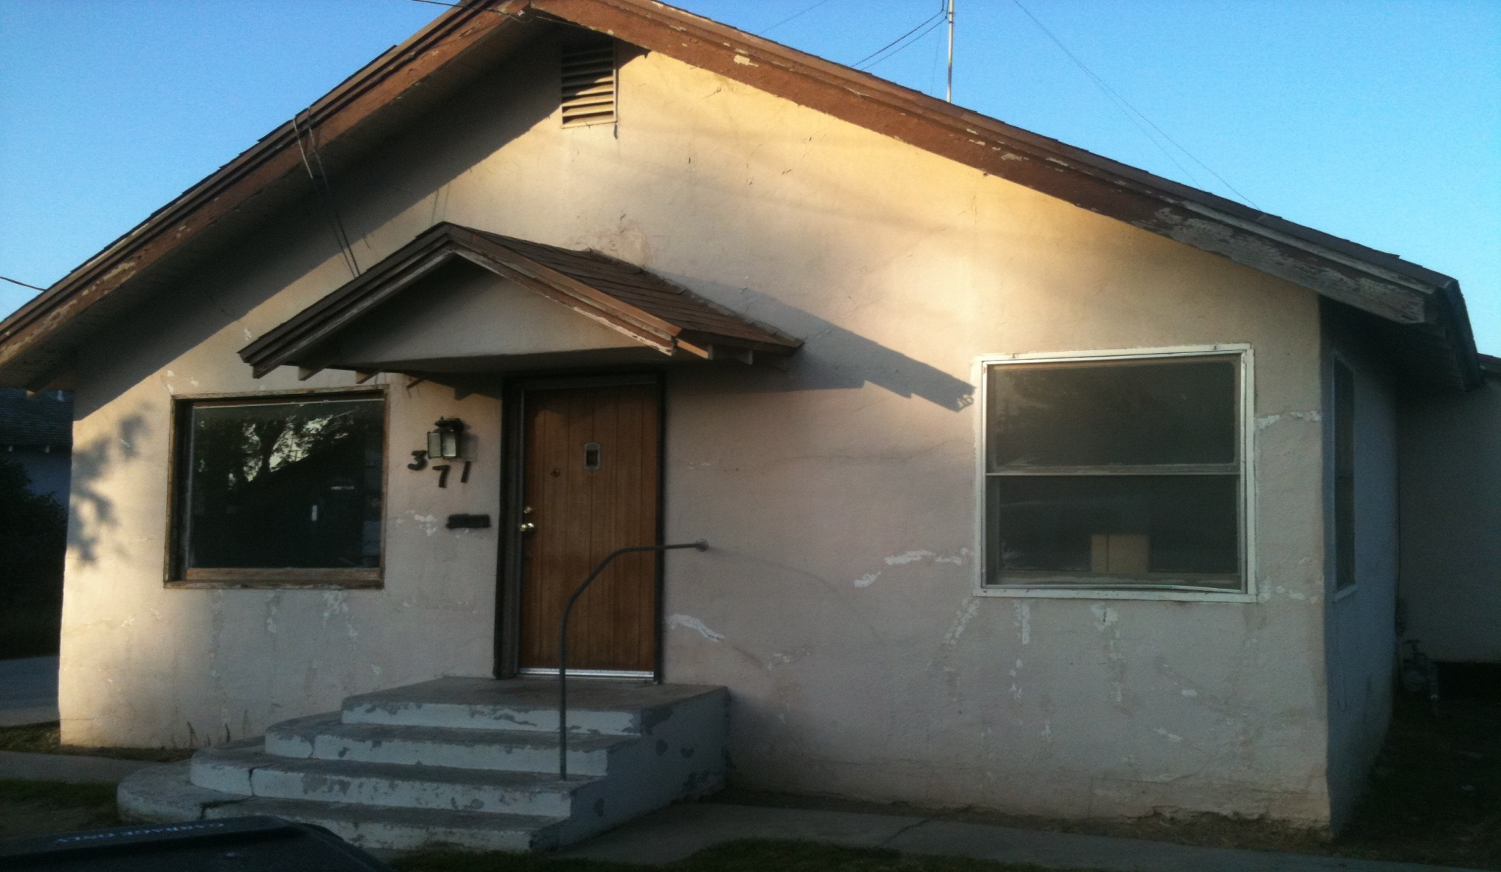
Wells Fargo-Donation house

Slide 17
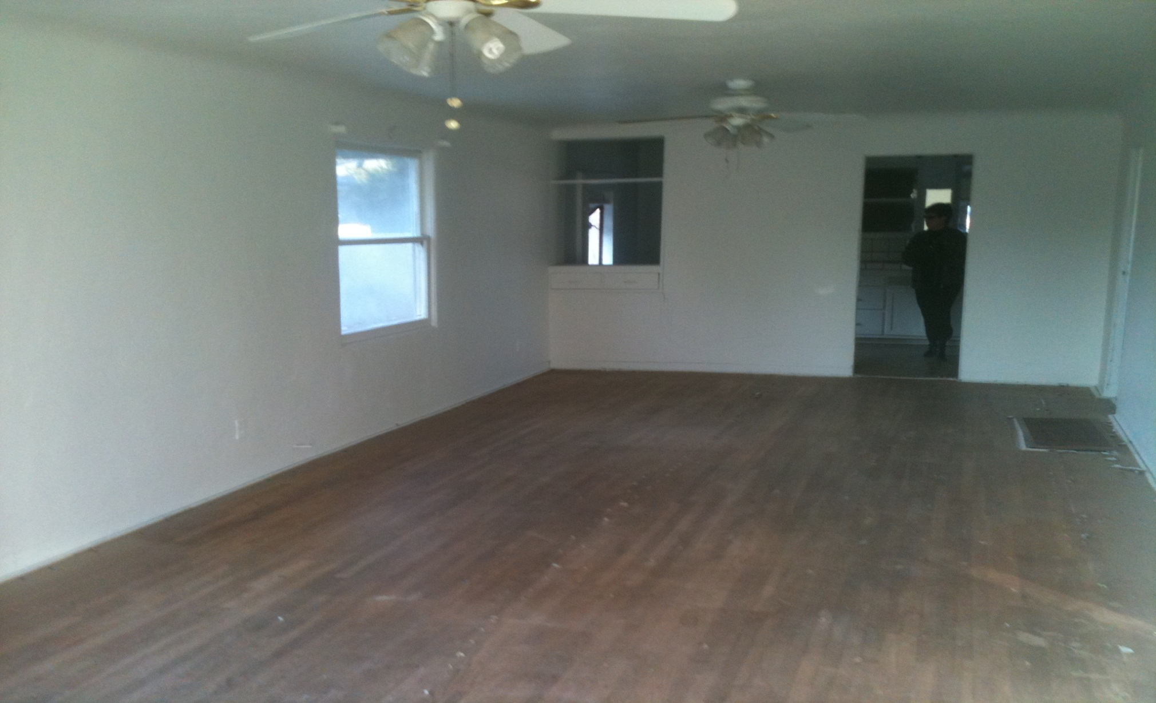
Wells Fargo-Donation house

Slide 18
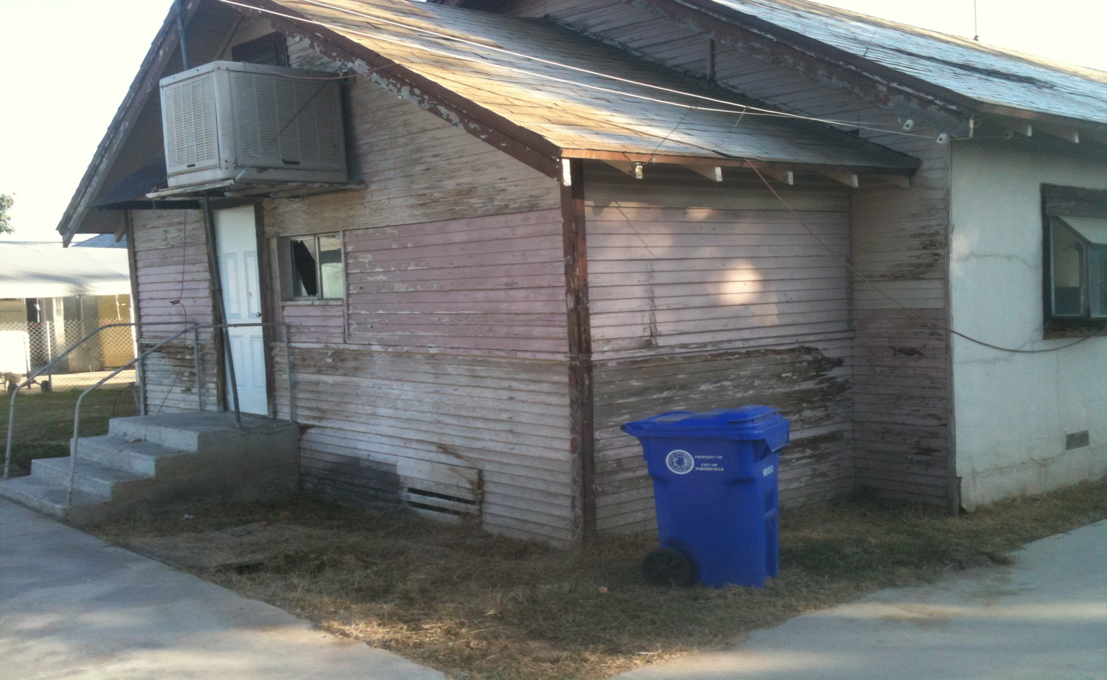
Wells Fargo-Donation house

Slide 19
Emerald Energy
Has developed a tree that is used for feedstock to make Ethanol
This tree is also used for Soil Remediation
Trees have a quick growth rate. Students can plant trees in the 9th grade and “harvest” the tree in the 12th grade year.
Emerald Energy has provided demonstrations, nursery tours, technical information, and support for the AERO students

Slide 20
Emerald Energy-MegaFlora tree
One year old tree:
Height of 25 feet
First year-energy is focused on developing the root system

Slide 21
Emerald Energy-MegaFlora Tree
Two Year old Tree
Height of 35 feet
50% of energy is focused on root development

Slide 22
Emerald Energy-Mega Flora Tree
Three Year old tree
Height of 50 feet
Majority of energy is focused on above-ground development-branches and leaves

Slide 23
GRID Alternatives
Has become a major partner in the PHS AERO Academy
Students participate in no fewer than two installations per school year
Students participate in a “Solarthon” each year. They will have their OSHA 10 certification and will be the safety officers on each house during the Solarthon

Slide 24
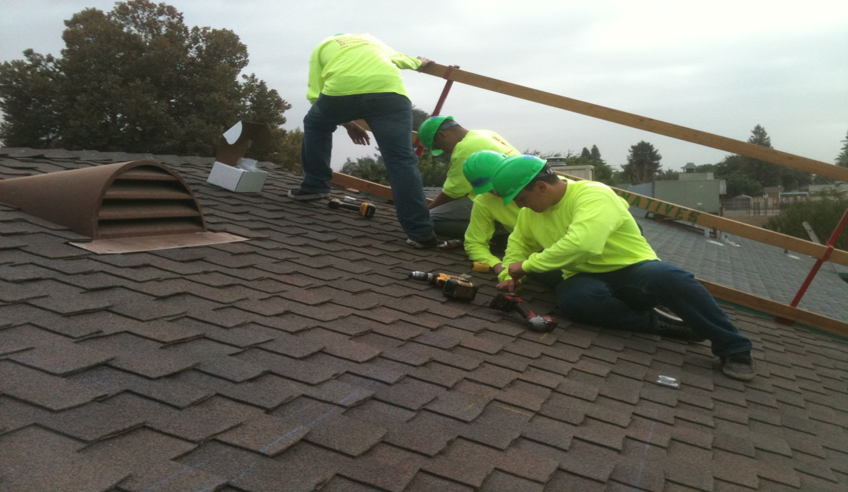
GRID Alternatives-Fall Semester 2013 Installation

Slide 25
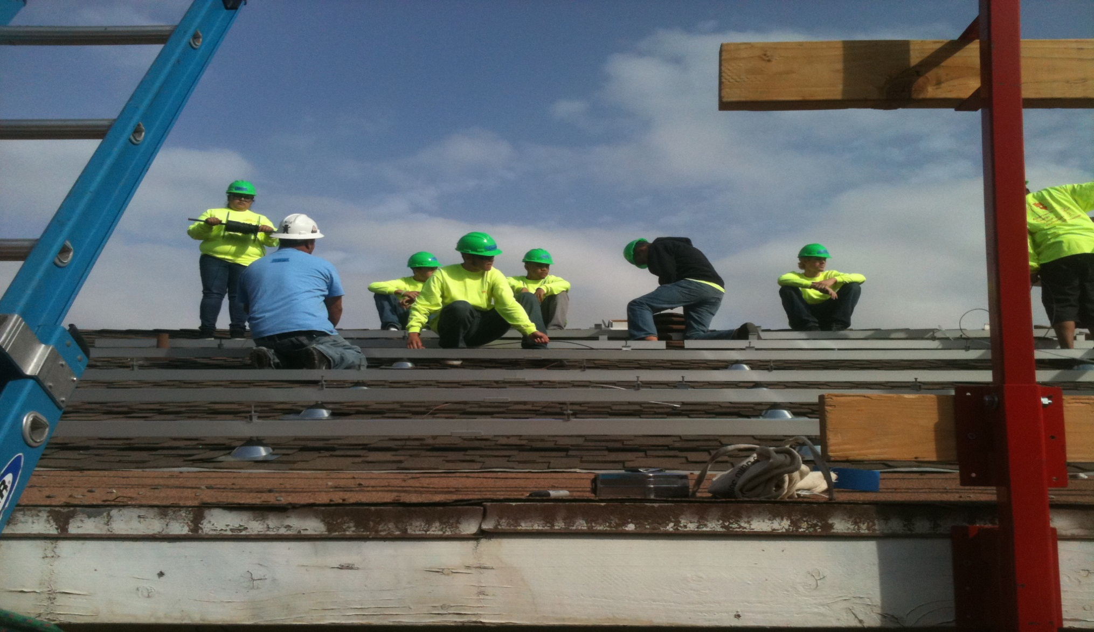
GRID Installation-Fall 2013

Slide 26
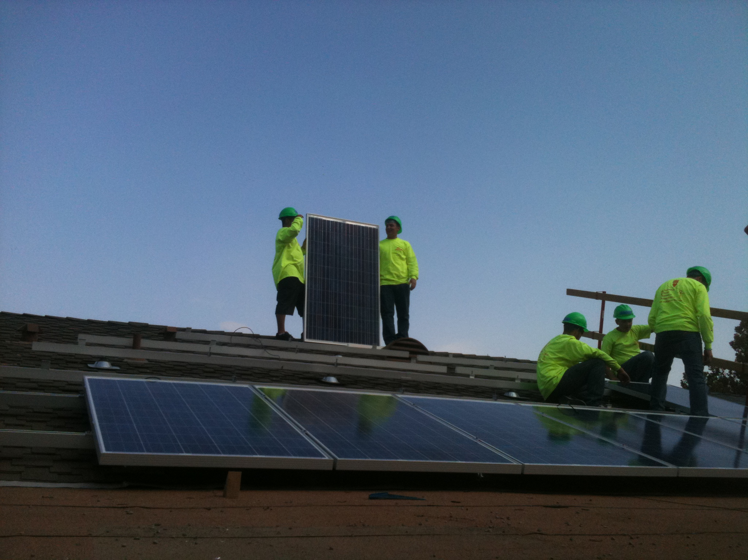
GRID Installation-Fall 2013

Slide 27
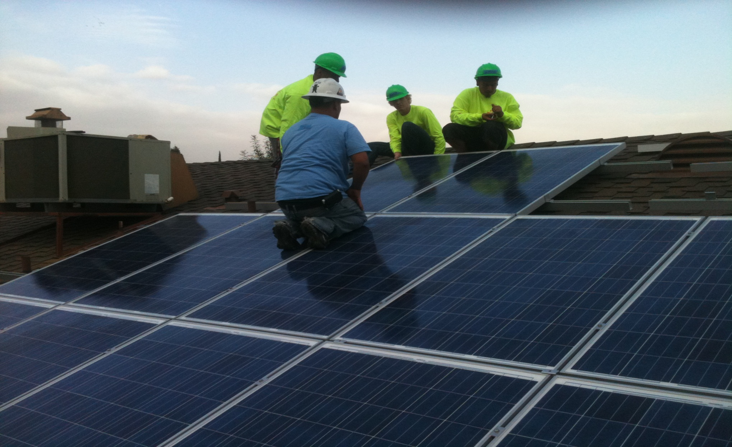
GRID Installation-Fall 2013

Slide 28
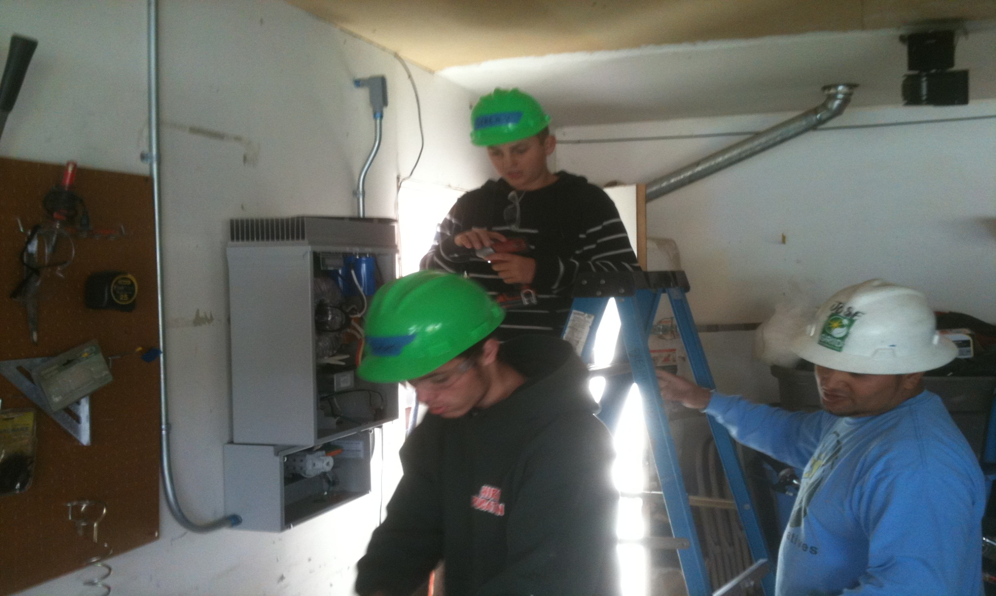
GRID Installation-Fall 2013

Slide 29
How we started with Grid Alternatives
Talked to Fresno Office Director Tom Esqueda and discussed working with out High School and college students.
We met at our campus and saw our facilities and program training areas
We were able to pilot an installation and it went very well!

Slide 30
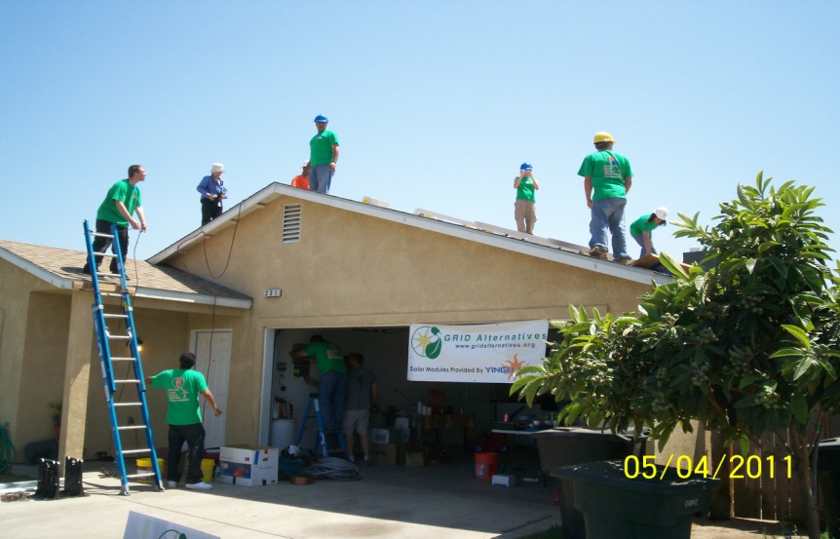
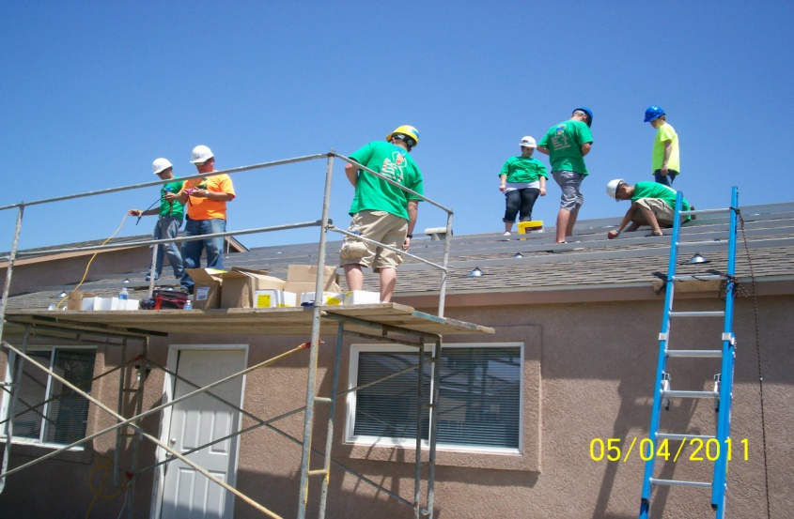
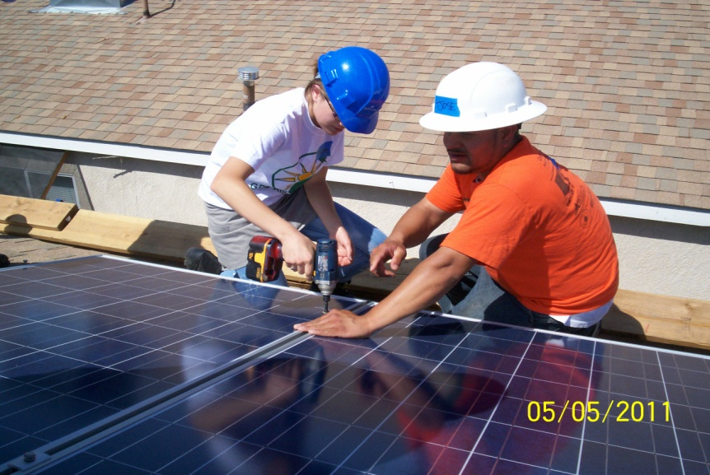
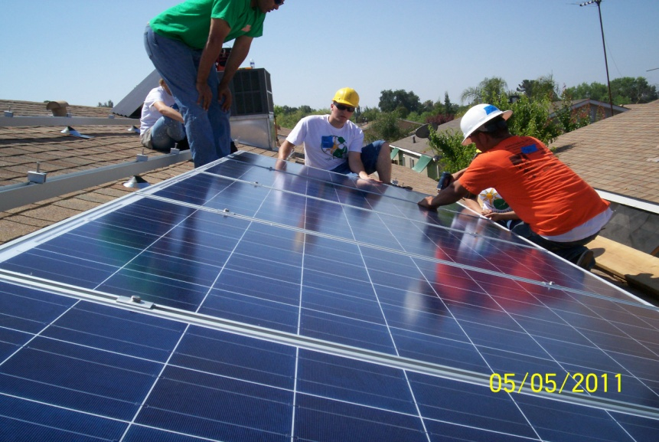
May 2011 Spring Installation Porterville

Slide 32
Indoor Solar Lab
Various solar modules on display
String inverters
Micro-inverters
Battery charging
LED Lighting trial

Slide 33
Southern CA Edison
Received a $25,000 grant from SCE to build and install a solar “farm” on campus for solar technology curriculum
Has provided tours of a solar farm in Porterville. This solar farm is a partnership between SCE and the City of Porterville
Has provided tours and instruction of the EEC center in nearby Tulare
Has provided training for teachers and students at the EEC Center in Tulare

Slide 34
Outdoor Solar Lab
Ground level roof mock up
20x20 in size
Set up to hold a max of 15 modules
Zomeworks passive tracker w/6 modules

Slide 35
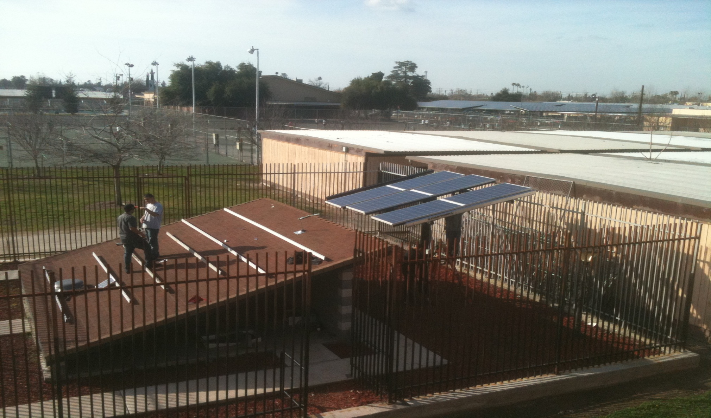
AERO Solar Farm

Slide 36
Circle J Norris Ranch
Students are working on a project named “Before the Fence”
Students will study the Environmental Impact and write the EI Report prior to a fence line being installed to protect a pond
Students will design and build a bridge to a pond island
Students will design and build shade structures for animals that reside on the ranch

Slide 37
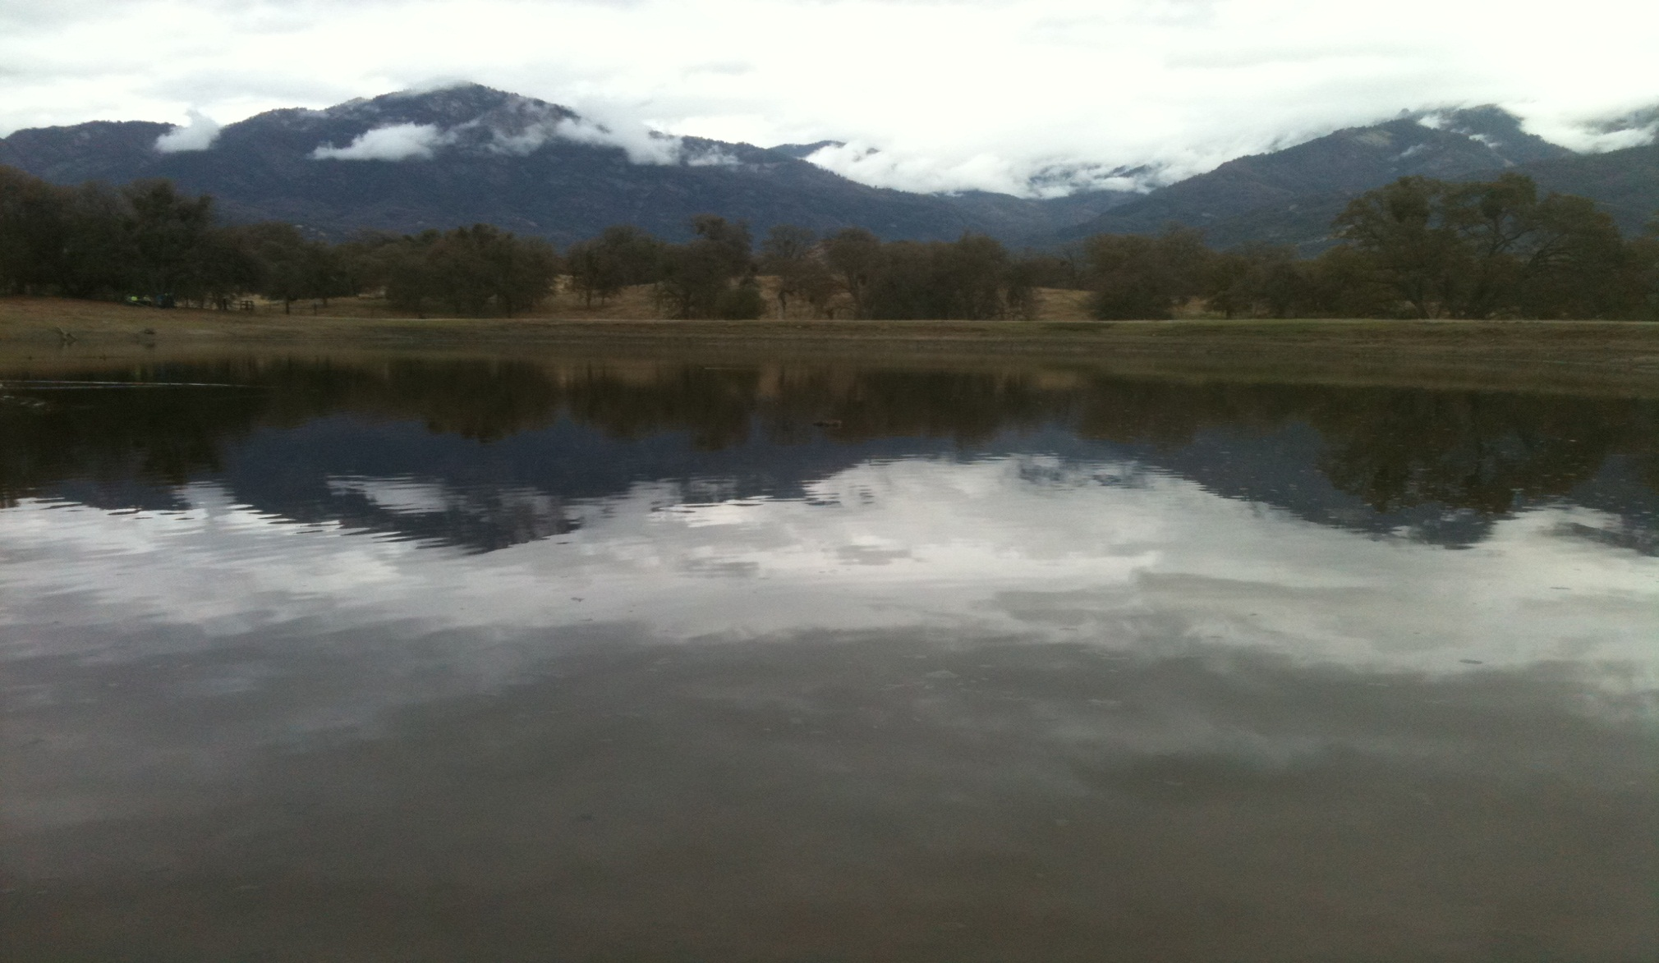
Circle J Norris ranch

Slide 38
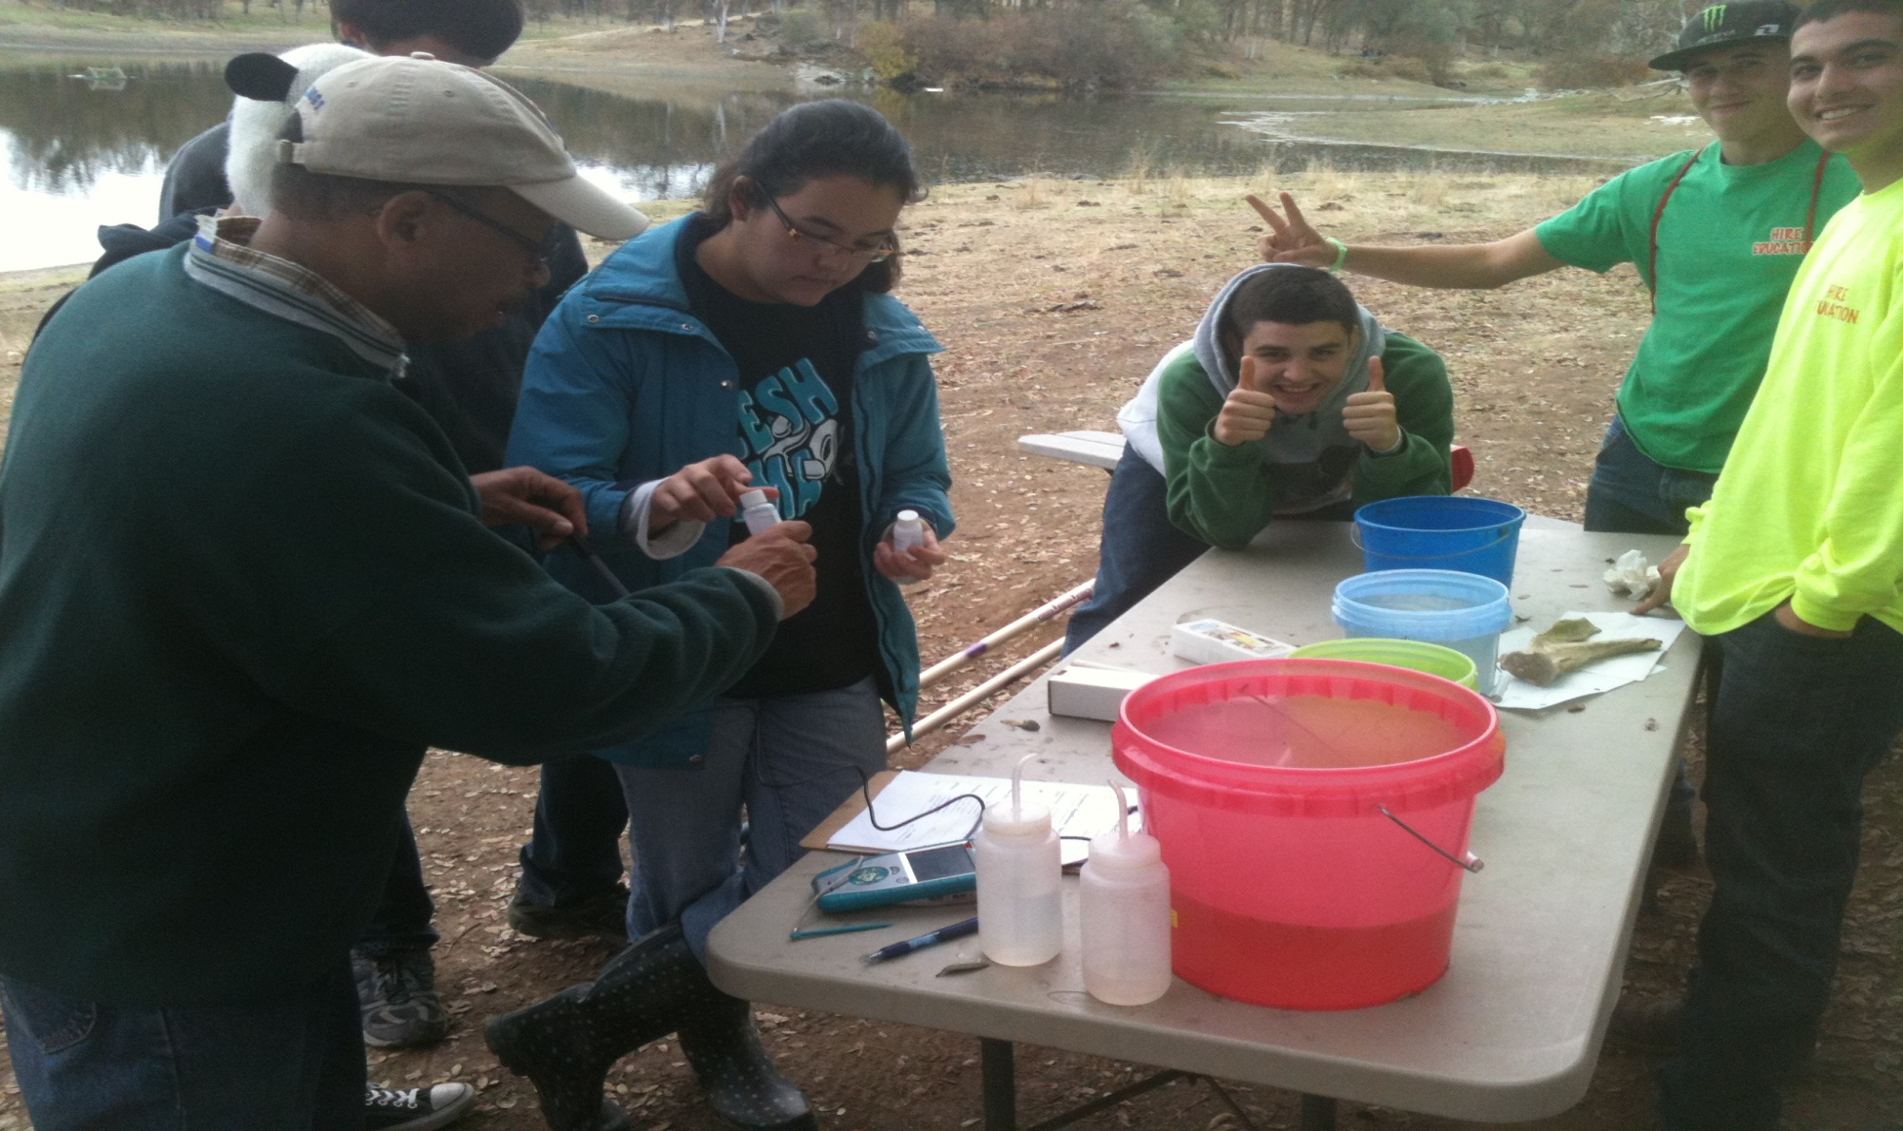
Circle J Norris Ranch

Slide 39
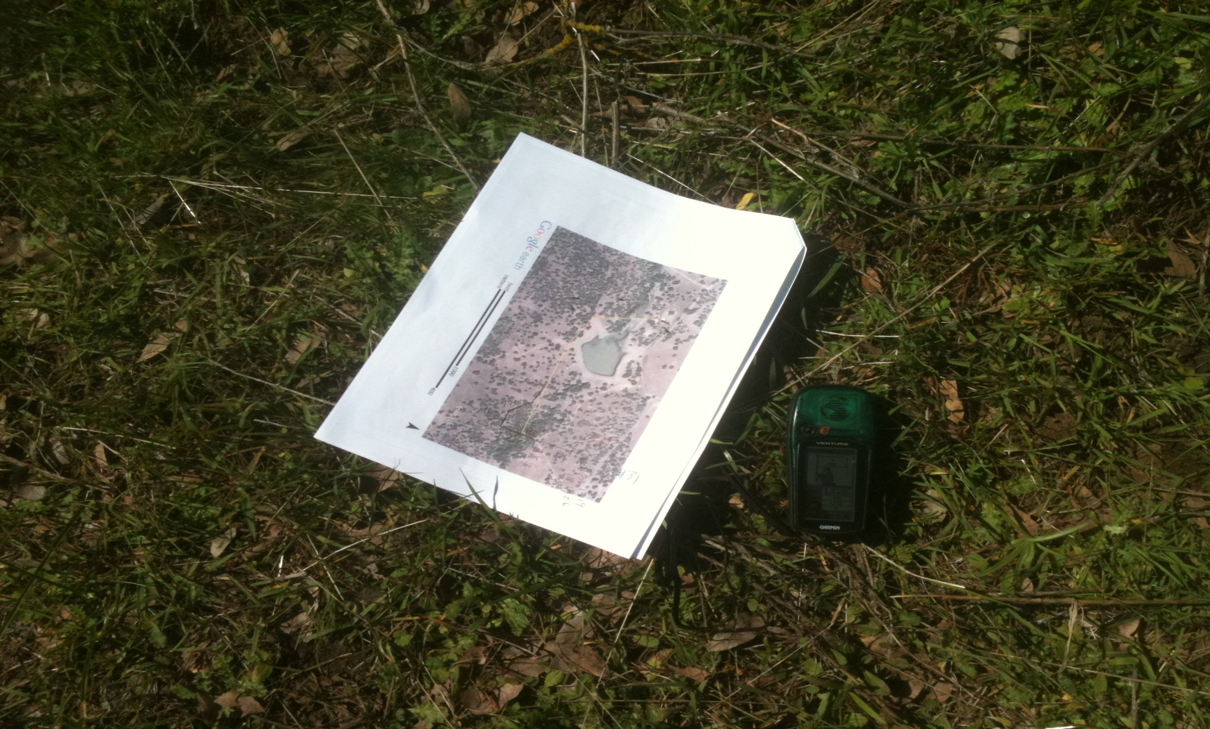
Circle J Norris Ranch

Slide 40
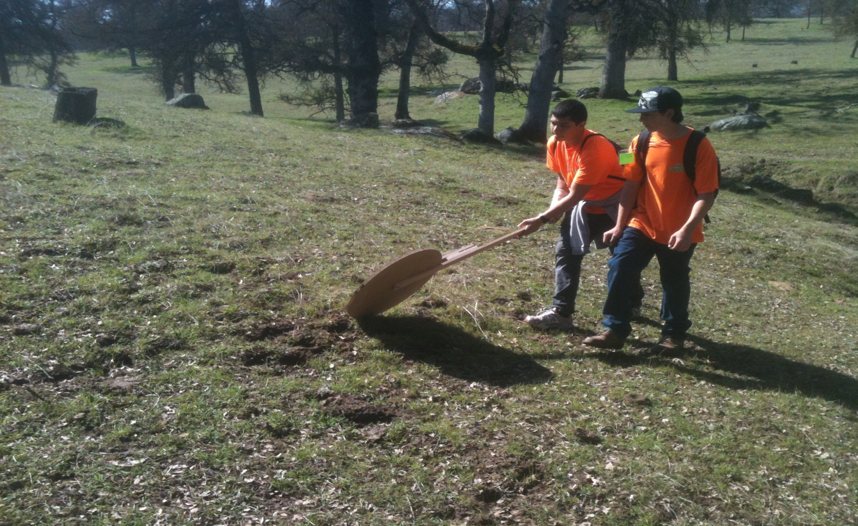
Circle J Norris Ranch

Slide 41
Porterville Museum Senior Project November 2011
Solar electric system for our local museum
Students designed and installed
15 module 3200w
Students now monitor the system weekly on the internet

Slide 42
Porterville High School Alternative Energy Resource Occupations (AERO) CPA “Green” Academy
Contact Information:
Porterville High School AERO Academy
465 West Olive Avenue
Porterville, CA 93257 (559)793-3498
Steve Graybehl-Principal
Christine Amann-Asst. Principal, AERO administrator
Raul Bermudez-Guidance Counselor
Brad Collins-CTE Instructor brad.collins@portervilleschools.org
Tom Reed-CTE Instructor treed@portervilleschools.org
Michael Beebe-English Instructor

Slide 43
Teach Safety
Students are taught essential standards for the construction industry. This training is intended for entry-level workers as an orientation and covers safety and health hazards workers might face on construction work site. This course puts emphasis on hazard identification, avoidance, control and prevention. Students will receive their OSHA-10 construction Outreach Completion Card and Completion Certificate

Slide 44
OSHA-10 Subject Areas
1. Introduction to OSHA
2. Material Handling
3. Tools-Hand and Power
4. Scaffolds
5. Stairways and Ladders
6. Excavations
7. Electrical
8. Personal Protective Equipment
9 Fall Protection
10. Cranes

Slide 45
Teach Billable Hours
We like to use a time card for instant feedback and instilling work ethic
Students must be taught the concept of Billable time.

